Slide 1
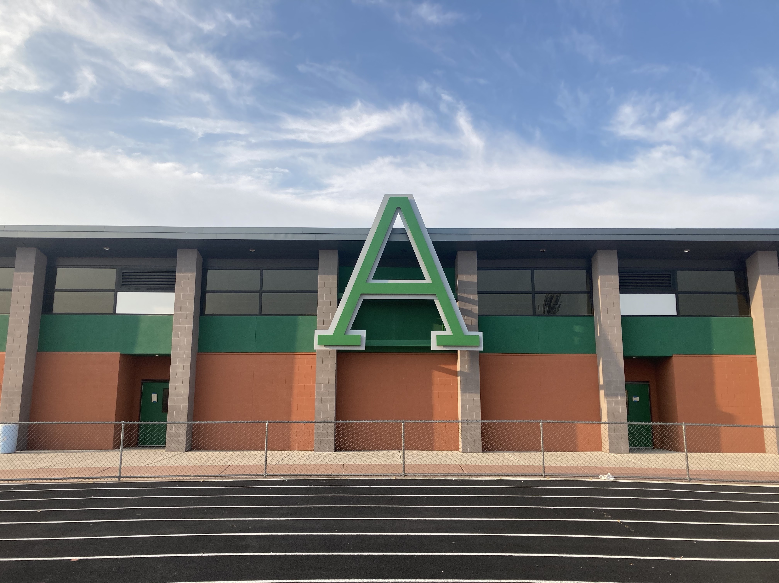
AMphitheater High School
Title 1 Program Information

Slide 2
Title 1 Program Intent and Purpose
Our school has been allocated $696,527.65 in federal Title I funds for use during this school year
These funds are given to schools with the specific purposes of:
Ensuring that all students receive a high-quality education from appropriately certified, effective, well-trained staff using evidence-based instructional methods.
Supporting struggling learners with additional resources and help in math and English Language Arts (ELA).
Educating and training families so that they may better support their students to achieve at high academic levels.

Slide 3
Budget and allocation
Staff salaries and benefits: $443,864.73
Intervention teachers, college advisor, AVID teachers, tutoring.
Academic Student Assessments: $33,000
Costs related to Advanced Placement (AP), Cambridge, and PSAT testing
Student programs supplies: $44,958.96
Outside vendor instructional aids
Capital items: $48,064.00
Anti-virus licenses for Title I computers, furniture/equipment, technology
Programmatic Membership Fees: $4684.00
AVID membership costs

Slide 4
Comprehensive Needs Assessment (CNA)
Our school leadership team completed a Comprehensive Needs Assessment to determine the following goals for school year 2023-2024:
Goal 1: Using data from gap analysis, staff will participate in Professional Learning Communities to impact student learning.
Goal 2: All staff will engage in intentional data collection learned through professional development and implemented through Professional Learning Communities with the goal of data driven instruction embedded in order to ensure continuous student improvement.
Goal 3: To increase the number of community volunteers, families attending events, and community partnerships focused on supporting student learning inside and outside the classroom.

Slide 5
Integrated Action Plan (IAP)
After completing the CNA, the Leadership Team developed goals (last slide) and determined to direct Title I funds in these areas:
AVID school wide: An AVID director will oversee school wide implementation of this program.
Students will have access to academic programs such as Cambridge, AP, dual enrollment and funds will be used to help students access assessments.
Professional Development will be provided to ensure teachers have understanding of AVID, Professional Learning Communities, and Personalized Competency Based Learning.

Slide 6
Integrated Action Plan (IAP)
Provide supplemental math and ELA instruction with appropriately certified teachers and tutors.
Provide technology and equipment to provide students with access to instructional materials to enhance their academic experience.
Provide a college advisor to work full-time with students to provide guidance and support for the development of college and career readiness and skills necessary to be successful post-secondary.
Provide post-secondary experiences for students by using supplemental funds to pay for students’ fees, field trips, and college visits.
Students will be provided the opportunity to experience academic content outside of the normal school setting.

Slide 7
State Assessments
The Amphitheater SD uses the following assessments to measure student progress:
ACT Aspire - 9th grade
ACT - 11th grade
AzSCI - 11th grade
All students taking these assessments are expected to meet either Proficient or Highly Proficient levels.

Slide 8
District Assessments
In addition to State assessments, our school uses MAP testing in math and ELA in order to measure student growth.
Teachers in those academic areas test 9th and 10th graders three times a year (August, December, and April) in order to provide data to students on their academic growth in those areas.

Slide 9
Academic Family Engagement
Our plan includes steps to promote academic family engagement such as:
School Parent Involvement Policy
Title 1 Parent Compact
Family Engagement: Calendar and Events published on website calendar and on social media.

Slide 10
Parents Right to know
You have the right to request:
The qualifications of your student’s teacher and instructional staff.
Your students’ level of achievement based on required state assessments
You must be informed within 4 weeks if:
Your student is not being taught by a teacher who does not meet the appropriately certified requirements of the state.
All of this information must be in a language and formate that is understandable to you.

Slide 11
Important dates to remember
Site Council meets monthly to review Title I budget updates as well as review other school based information. Meeting are open to the public.
October 16, 2022 | January 22, 2024
November 20, 2023 | February 19, 2024
December 18, 2023 | March 25, 2024
 | April 22, 2024
Meetings are held in the AHS Library classroom from 6:30-8:00 PM

Slide 12
Questions?
For more information about Title I or to learn more about how to get involved with reviewing the Comprehensive Needs Assessment and developing the Integrated Action Plan, contact principal A.J. Malis at amalis@amphi.com

